Slide 1
Agile

Slide 2
Objective
Traditional Methodologies
Agile Overview

Slide 3
Traditional Methodologies

Slide 4
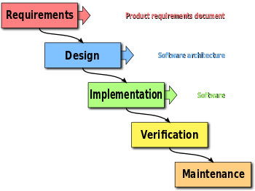
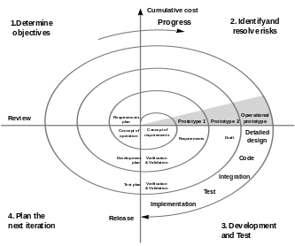
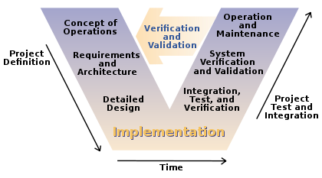
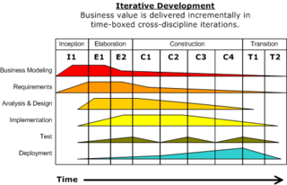
Traditional Methodologies
3
1
4
2

Slide 5
Problems with Traditional Model
Requirements Not Clear
Fear to go to the next phase
Analysis paralysis
Change gets more and more expensive
Customers don’t get what they want
Project Takes Too Long
34% of projects delivered successfully
Long duration defers revenue
Time Wasted on Junk
52% of requirements implemented
64% of functionality rarely used
Requirements needs to be frozen before we proceed to design
Business demands faster time to market to achieve first mover advantage
Many things are done which are not directly linked with Software to be delivered
Source: Standish Report 2003

Slide 6
Getting To “Done” – Not a Good Way
Requirement Gathering
ANALYSIS
DESIGN
CODE
TEST
S P R I N T
Project Timeline

Slide 7
Getting To “Done” – A Good Way
ANALYSIS
CODE
TEST
DESIGN
S P R I N T
Iteration

Slide 8
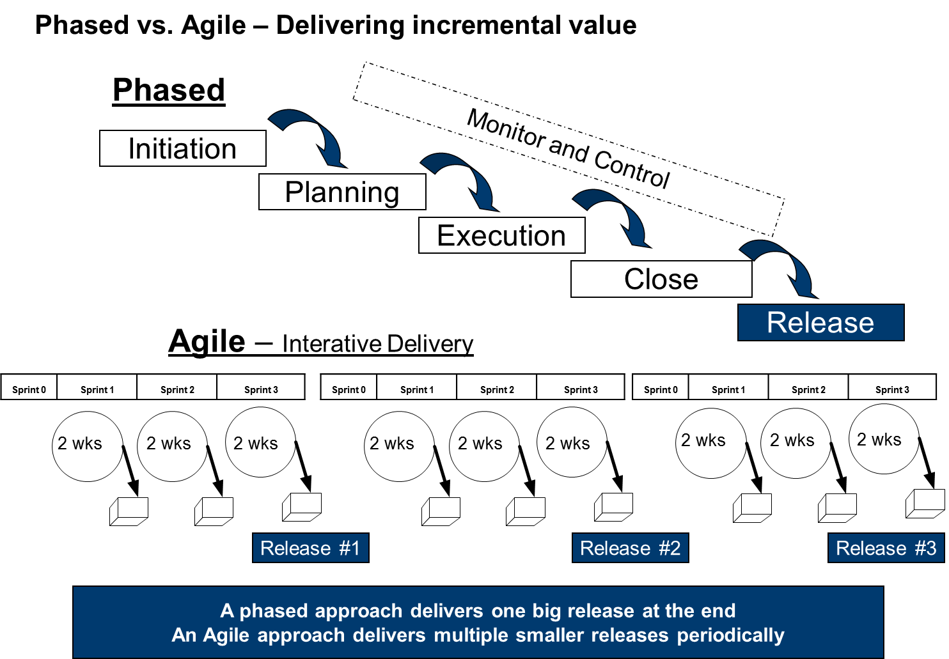

Slide 9
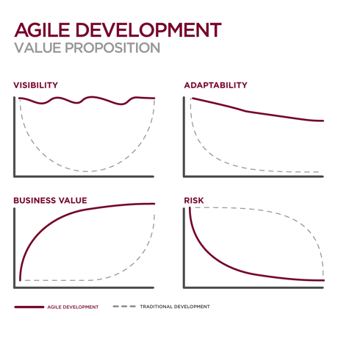
Agile Vs. Waterfall
Applying Agile principles and paradigm is the foundation of creating high performance teams
87% say agile improved their ability to manage changing priorities*
82% say that agile improves project visibility*
30-100% productivity improvement
100%+ improvement time to market
* https://www.versionone.com/pdf/state-of-agile-development-survClient-ninth.pdf

Slide 10
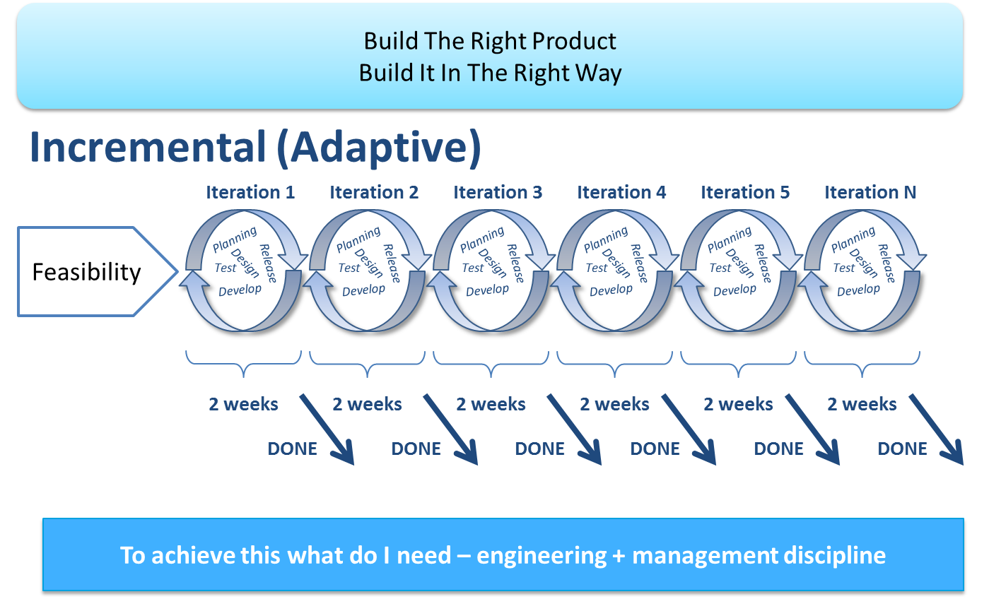
Agile Software Development

Slide 11
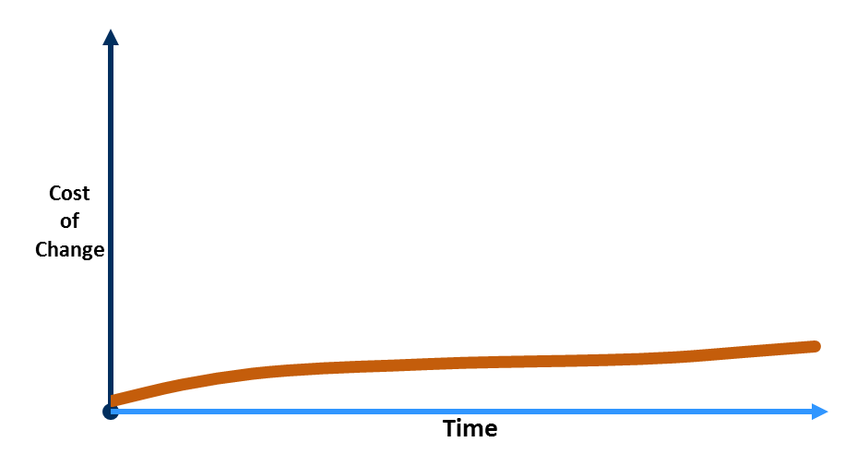
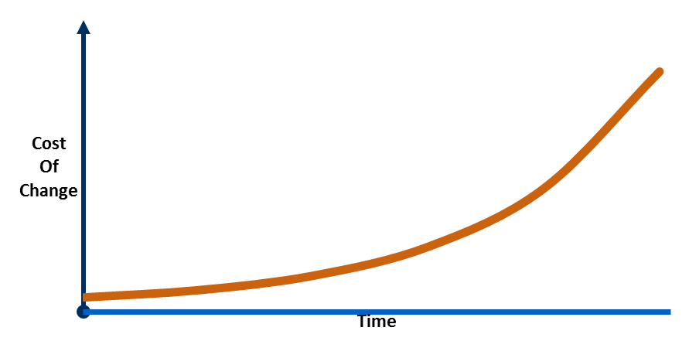
Traditional Vs Agile
Traditional: Independent functional groups
Requirements
Business Requirements
Technical Requirements
Analysis & Design
System Specifications
Component Specifications
Code
C#, C, C++ etc.
Test
Deploy
Big-Bang Integration
Validation Tests
Verification Tests
BA’s
Tester
Dev
Iteration 1
Requirements
Analysis & Design
Code
Test
Requirements
Analysis & Design
Code
Test
Deploy
Iteration 2
Requirements
Analysis & Design
Code
Test
Iteration 3
Requirements
Analysis & Design
Code
Test
Iteration 4
Agile: Works as one team
Domain
Expert
Programmer
Tester

Slide 12
Valuable Delivery
Traditional Approach
Agile Approach
Quality
Scope
Cost
Time
Quality
Scope
Cost
Time
Fixed
Variable

Slide 13
Agile Overview

Slide 14
What is Agile?
An alternative to documentation driven, heavyweight software development
A way to respond to “Change in Requirements” during the Software Development
Reduce efforts involved in planning and estimation
Focus on team interaction, customer satisfaction and early delivery of working software
Progressive Elaboration involves continuously improving and detailing a plan as more detailed and specific information and more accurate estimates become available.
Progressive Elaboration allows a project management team to manage to a greater level of details as the project evolves.
- Ref. PMBOK V4

Slide 15


Agile Manifesto – a statement of values
Individuals and interactions
Process and tools
over
Working software
Comprehensive documentation
over
Customer collaboration
Contract negotiation
over
Responding to change
Following a plan
over

Slide 16
Agile Principles
Our highest priority is to satisfy the customer through early and continuous delivery of valuable software
Welcome changing requirements, even late in development. Agile processes harness change for the customer's competitive advantage.
Deliver working software frequently, from a couple of weeks to a couple of months, with a preference to the shorter timescale
Business people and developers must work together daily throughout the project
Build projects around motivated individuals. Give them the environment and support they need, and trust them to get the job done.
At regular intervals, the team reflects on how to become more effective, then tunes and adjusts its behavior accordingly
The most efficient and effective method of conveying information to and within a development team is face-to-face conversation
Working software is the primary measure of progress.
Agile processes promote sustainable development. The sponsors, developers, and users should be able to maintain a constant pace indefinitely
Continuous attention to technical excellence and good design enhances agility
Simplicity- the art of maximizing the amount of work not done - is essential
The best architectures, requirements, and designs emerge from self-organizing teams
Notes:
Principles behind the Agile Manifesto We follow these principles:
1. Our highest priority is to satisfy the customer through early and continuous delivery of valuable software.
2. Welcome changing requirements, even late in development. Agile processes harness change for the customer's competitive advantage.
3. Deliver working software frequently, from a couple of weeks to a couple of months, with a preference to the shorter timescale.
4. Business people and developers must work together daily throughout the project.
5. Build projects around motivated individuals. Give them the environment and support they need, and trust them to get the job done.
6. The most efficient and effective method of conveying information to and within a development team is face-to-face conversation.
7. Working software is the primary measure of progress.
8. Agile processes promote sustainable development. The sponsors, developers, and users should be able to maintain a constant pace indefinitely.
9. Continuous attention to technical excellence and good design enhances agility.
10. Simplicity--the art of maximizing the amount of work not done--is essential.
11. The best architectures, requirements, and designs emerge from self-organizing teams.
12. At regular intervals, the team reflects on how to become more effective, then tunes and adjusts its behavior accordingly.

Slide 17

Agile Advantage
No need in long documentation and detailed specification
Easy adjustment to new requirements
Process visibility and high interaction between a customer and a team
Knowledge sharing for making better decisions
Reduced project development time frames
Business risks are minimized
Notes:
Principles behind the Agile Manifesto
We follow these principles: Our highest priority is to satisfy the customer through early and continuous delivery of valuable software.
Welcome changing requirements, even late in development. Agile processes harness change for the customer's competitive advantage.
Deliver working software frequently, from a couple of weeks to a couple of months, with a preference to the shorter timescale.
Business people and developers must work together daily throughout the project.
Build projects around motivated individuals. Give them the environment and support they need, and trust them to get the job done.
The most efficient and effective method of conveying information to and within a development team is face-to-face conversation.
Working software is the primary measure of progress.
Agile processes promote sustainable development. The sponsors, developers, and users should be able to maintain a constant pace indefinitely.
Continuous attention to technical excellence and good design enhances agility.
Simplicity--the art of maximizing the amount of work not done--is essential.
The best architectures, requirements, and designs emerge from self-organizing teams.
At regular intervals, the team reflects on how to become more effective, then tunes and adjusts its behavior accordingly.

Slide 18
Story Writing Exercise

Slide 19

User Stories
List of requirement will be specified in an organized way i.e; User Stories
User Stories are the functionalities to be delivered in the Scrum.
Functionalities will be specified User perceptive
Ideal User Story format will be like
As a User <Role> I want < Condition> So that, I can achieve < desired goal>
Objectives of User Stories
Card: Stories are written on note cards and will be divided as tasks
Confirmation: Acceptance test will be conducted Story developed properly

Slide 20
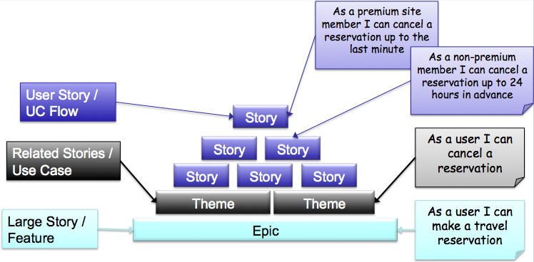
More About User Stories
Better understanding of what is really valuable for the user
More flexibility with Planning Prioritizing and cutting scope
More Knowledge about what to build
A Good Story
Independent
Negotiable
Valuable
Estimable
Small
Testable

Slide 21
User Story Example
Example of a good user story
As a financial advisor, I should be able to capture the retirement savings in the system for a client so that I can calculate his/her financial worth
Some reasons why this is good
It follows the “INVEST” criteria
It is from an end user perspective
Since it is vertically sliced, can be demoed, tested and deployed as needed
Example of not so good user story
The system shall be able to store the retirement savings detail in the database
Some reasons why this is not so good
Story written from a technical developer perspective and not from an end-user
Is not vertically sliced – talks only about the database layer
Objective (goal) of the story is unclear

Slide 22
Agile Prioritization
MoSCoW Prioritization Scheme
Must have
Should have
Could have
Wont to have

Slide 23
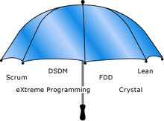
Agile Methodologies
SCRUM
3 Roles
4 Ceremonies
3 Artifacts
Lean
7 Principles
8 Wastes
22 Thinking Tools
XP
5 Values
12 Primary Practices
11 Corollary Practice
Notes:
As we have learnt earlier there are many methodologies under Agile Umbrella

Slide 24
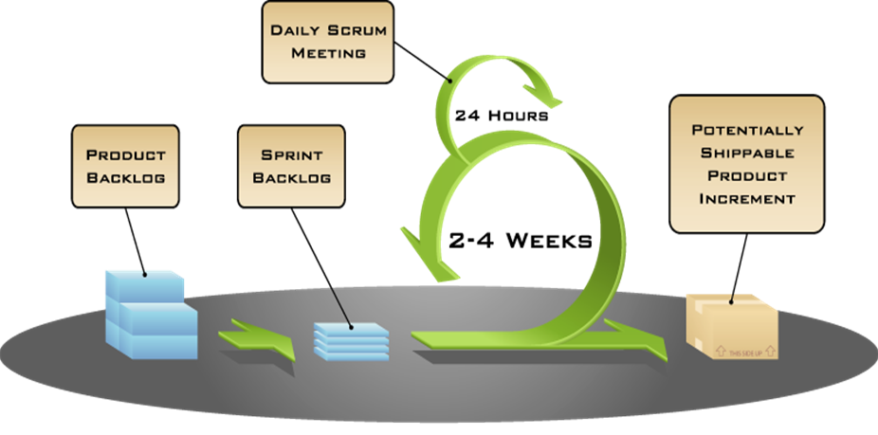
Scrum
Ceremonies
Sprint Planning Meeting
Daily Scrum Meetings
Sprint Review & Retrospective
Artifacts
Product Backlog
Sprint Backlog
Burn down Chart
Plus
Release Planning Meeting
Roles
- Product Owner
- Scrum Master
- Team

